Slide 1

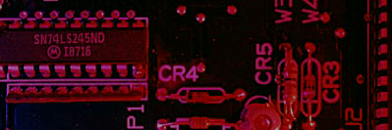
Summary
Combinational and Sequential Circuit
S
Q
Q
R

Slide 2
Summary
Combinational circuits are defined as the time independent circuits which do not depends upon previous inputs to generate any output are termed as combinational circuits.
S
Q
Q
R

Slide 3
Summary
Combinational Circuit –
In this output depends only upon present input.
Speed is fast.
It is designed easy.
There is no feedback between input and output.
This is time independent.
Elementary building blocks: Logic gates
Combinational circuits don’t have capability to store any state
These circuits do not have any memory element
S
Q
Q
R

Slide 4
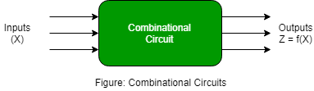
Summary
Combinational Circuit Exemples – Encoder, Decoder, Multiplexer, Demultiplexer
S
Q
Q
R

Slide 5
Summary
Sequential circuits are those which are dependent on clock cycles and depends on present as well as past inputs to generate any output.
S
Q
Q
R

Slide 6
Summary
Sequential Circuit –
Output depends upon present as well as past input.
Speed is slow.
It is designed tough as compared to combinational circuits.
There exists a feedback path between input and output.
Time dependent.
Elementary building blocks: Flip-flops
Mainly used for storing data.
Sequential circuits have capability to store any state or to retain earlier state.
As sequential circuits are clock dependent they need triggering.
These circuits have memory element.
S
Q
Q
R

Slide 7
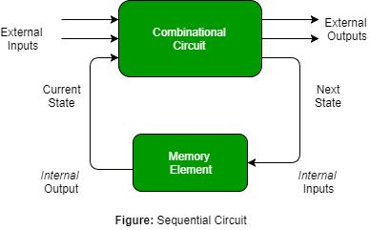
Summary
Sequential Circuit Examples – Flip-flops, Counters
S
Q
Q
R

Slide 8
Latches

Slide 9
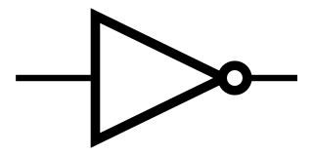
0
1
0
INPUT

Slide 10
INPUT
1
0
1

Slide 11
Summary
Latches
A latch is a temporary storage device that has two stable states (bistable). It is a basic form of memory.
The S-R (Set-Reset) latch is the most basic type. It can be constructed from NOR gates or NAND gates. With NOR gates, the latch responds to active-HIGH inputs; with NAND gates, it responds to active-LOW inputs. It can be set using the one input and reset to 0 using the another input.
R
Q
S
Q
Q
Q
S
R
NOR Active-HIGH Latch NAND Active-LOW Latch

Slide 12
S
Summary
Latches
The active-LOW S-R latch is in a stable (latched) condition when both inputs are HIGH.
Assume the latch is initially RESET (Q = 0) and the inputs are at their inactive level (1). To SET the latch (Q = 1), a momentary LOW signal is applied to the S input while the R remains HIGH.
1
1
0
Q
Latch initially RESET
0
1
Q
1
R
To RESET the latch a momentary LOW is applied to the R input while S is HIGH.
1
S
0
1
Q
Latch initially SET
Never apply an active set and reset at the same time (invalid).
1
0
1
Q
R

Slide 13
Summary
Latches
The active-HIGH S-R latch is in a stable (latched) condition when both inputs are LOW.
0
R
1
Assume the latch is initially RESET (Q = 0) and the inputs are at their inactive level (0). To SET the latch (Q = 1), a momentary HIGH signal is applied to the S input while the R remains LOW.
0
Q
Latch initially RESET
0
1
Q
0
S
0
R
0
To RESET the latch (Q = 0), a momentary HIGH signal is applied to the R input while the S remains LOW.
1
Q
Latch initially SET
1
0
Q
0
S

Slide 14
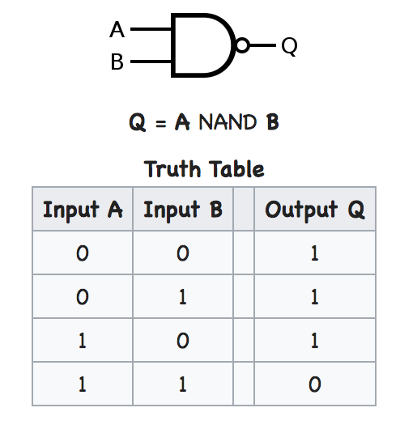
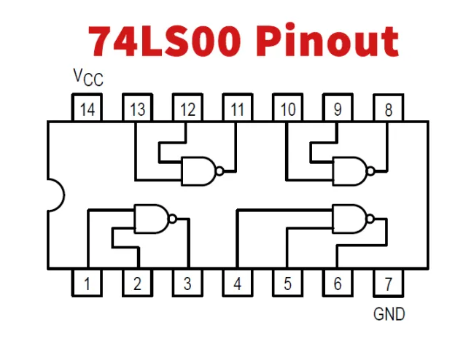
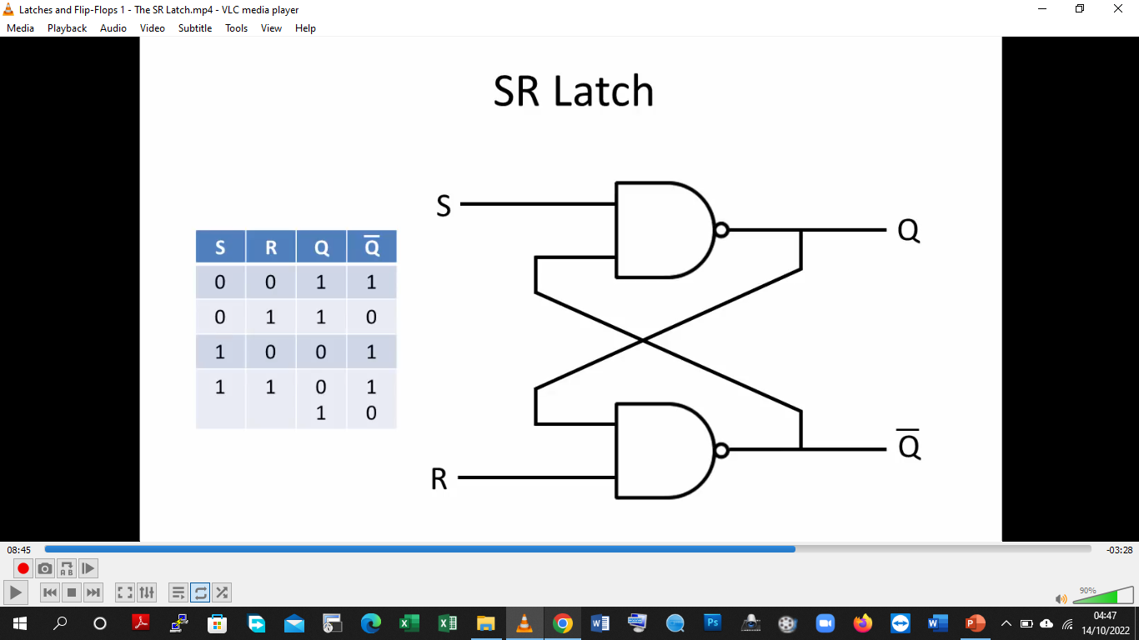
0
1
Invalid State
1
0

Slide 15
0
1
0
Invalid State
Set State
Set State = Q= high
1
0
1

Slide 16
1
0
1
Invalid State
Set State
Reset State = Q= high
Reset State
0
1
0

Slide 17
1
0
1
Invalid State
Set State
Reset State
No Change State
0
1
1

Slide 18
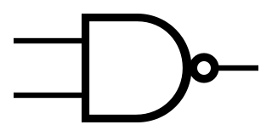
Invalid State
Set State
Reset State
No Change State
S
0
S*
CR | S | R | Q
X | 0 | 0 | No Chng
CLK
0
R*
R
0

Slide 19
Invalid State
Set State
Reset State
No Change State
S
0
1
S*
CR | S | R | Q
X | 0 | 0 | no Chn
1 | 0 | 1 | reset
CLK
1
0
R*
R
1

Slide 20
Invalid State
Set State
Reset State
No Change State
S
1
0
S*
CR | S | R | Q
X | 0 | 0 | No Ch
1 | 0 | 1 | Reset
1 | 1 | 0 | Set
CLK
1
1
R*
R
0

Slide 21
Invalid State
Set State
Reset State
No Change State
S
1
0
S*
CR | S | R | Q
X | 0 | 0 | Previous
1 | 0 | 1 | Reset
1 | 1 | 0 | Set
1 | 1 | 1 | Invalid
CLK
1
0
R*
R
1

Slide 22
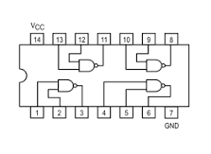
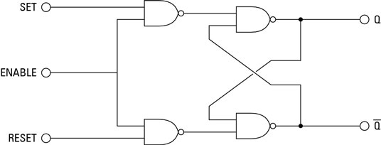
Summary
Latches
A gated latch is a variation on the basic latch.
The gated latch has an additional input, called enable (EN) that must be HIGH in order for the latch to respond to the S and R inputs.

Slide 23
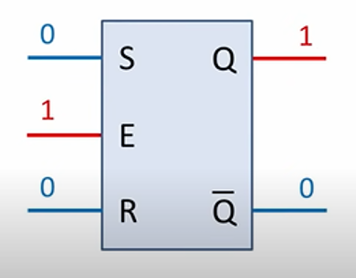
Summary
Latches
A gated latch is a variation on the basic latch.
The gated latch has an additional input, called enable (EN) that must be HIGH in order for the latch to respond to the S and R inputs.

Slide 24
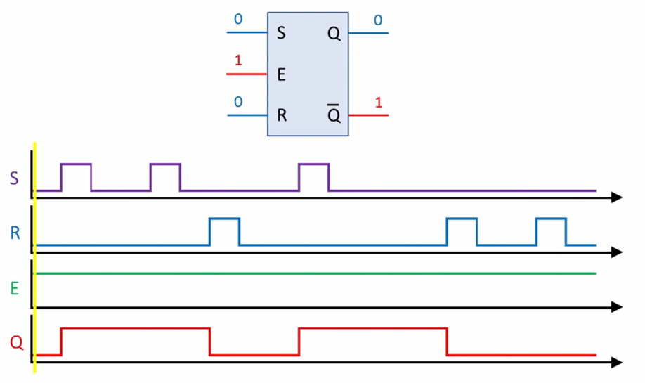
Summary
Latches
A gated latch is a variation on the basic latch.
The gated latch has an additional input, called enable (EN) that must be HIGH in order for the latch to respond to the S and R inputs.

Slide 25
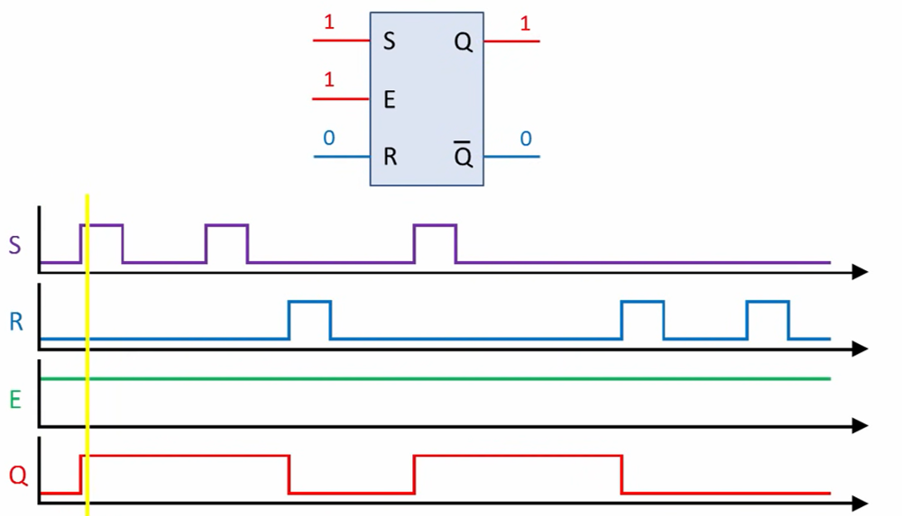
Summary
Latches
A gated latch is a variation on the basic latch.
The gated latch has an additional input, called enable (EN) that must be HIGH in order for the latch to respond to the S and R inputs.

Slide 26
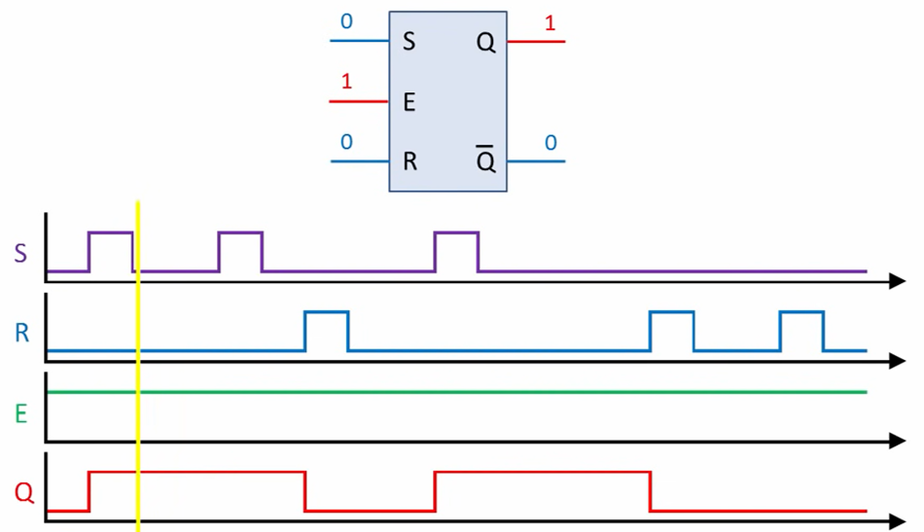
Summary
Latches
A gated latch is a variation on the basic latch.
The gated latch has an additional input, called enable (EN) that must be HIGH in order for the latch to respond to the S and R inputs.

Slide 27
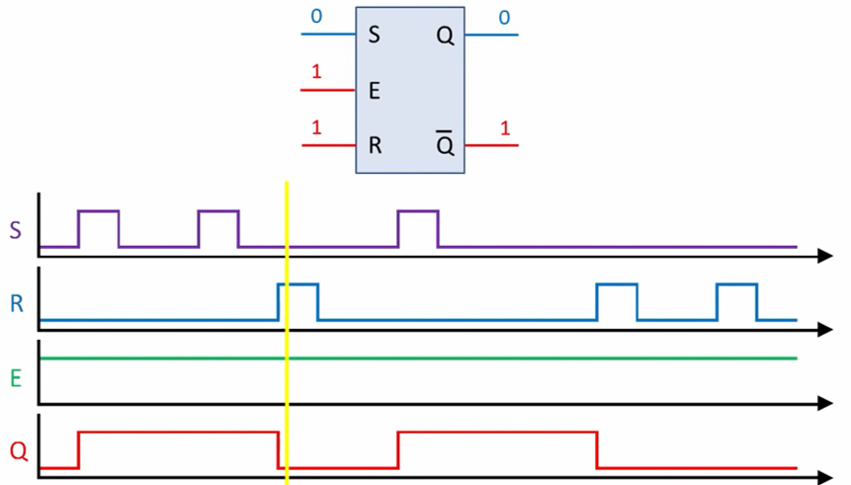
Summary
Latches
A gated latch is a variation on the basic latch.
The gated latch has an additional input, called enable (EN) that must be HIGH in order for the latch to respond to the S and R inputs.

Slide 28
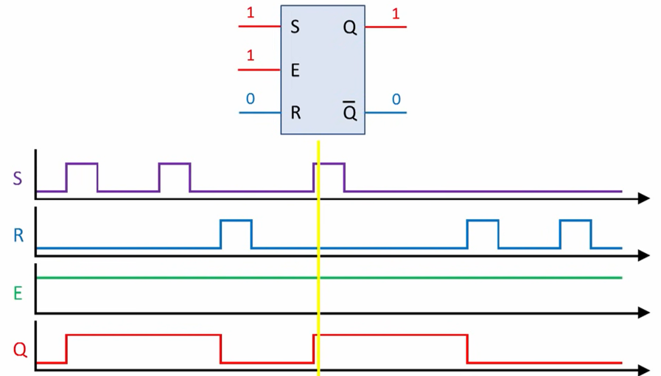
Summary
Latches
A gated latch is a variation on the basic latch.
The gated latch has an additional input, called enable (EN) that must be HIGH in order for the latch to respond to the S and R inputs.

Slide 29
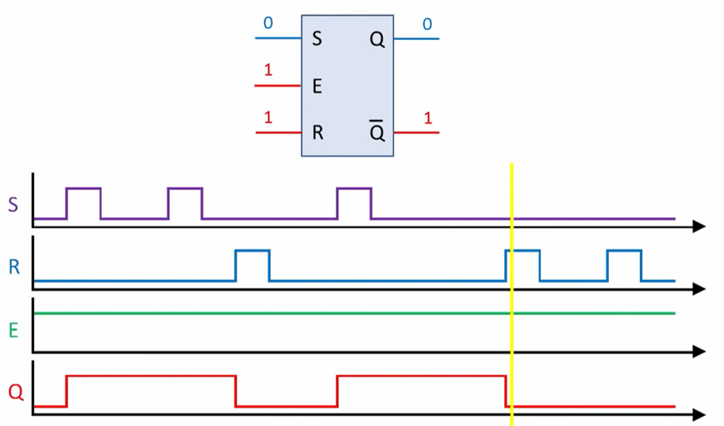
Summary
Latches
A gated latch is a variation on the basic latch.
The gated latch has an additional input, called enable (EN) that must be HIGH in order for the latch to respond to the S and R inputs.

Slide 30
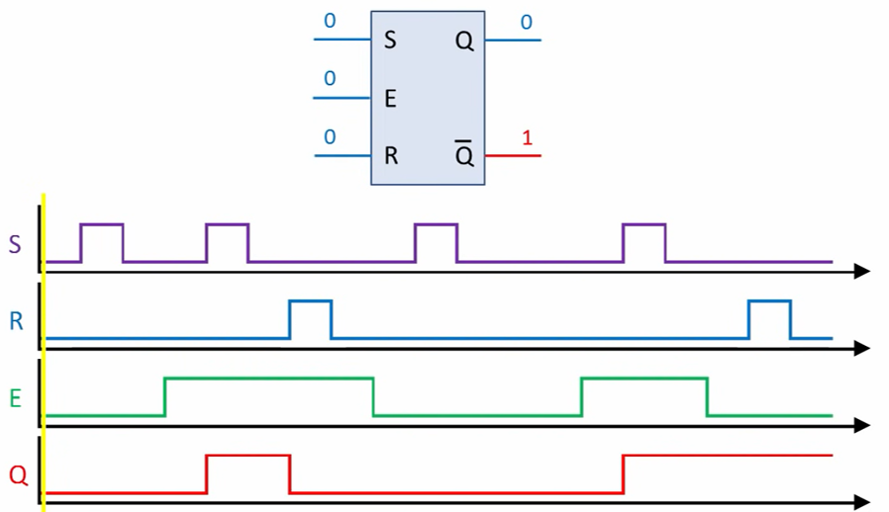
Summary
Latches
A gated latch is a variation on the basic latch.
The gated latch has an additional input, called enable (EN) that must be HIGH in order for the latch to respond to the S and R inputs.

Slide 31
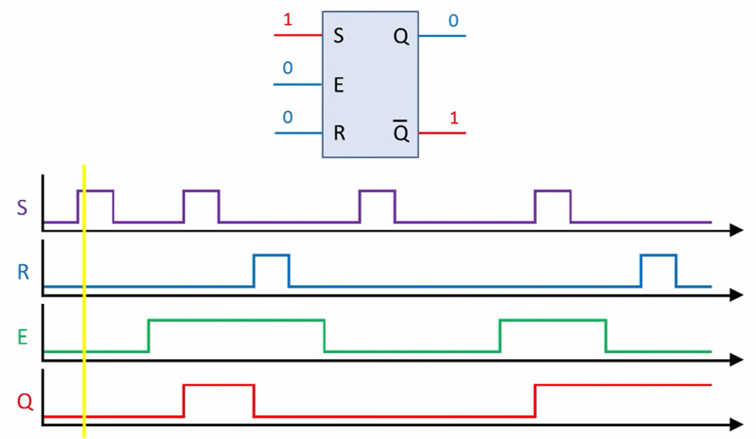
Summary
Latches
A gated latch is a variation on the basic latch.
The gated latch has an additional input, called enable (EN) that must be HIGH in order for the latch to respond to the S and R inputs.

Slide 32
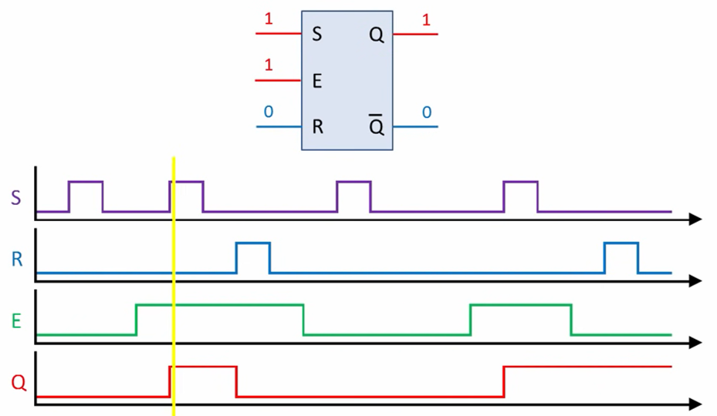
Summary
Latches
A gated latch is a variation on the basic latch.
The gated latch has an additional input, called enable (EN) that must be HIGH in order for the latch to respond to the S and R inputs.

Slide 33
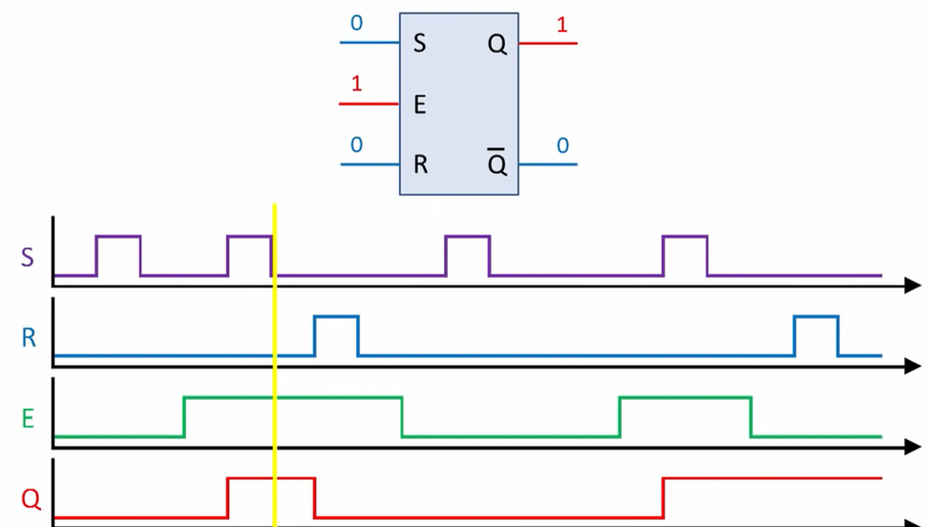
Summary
Latches
A gated latch is a variation on the basic latch.
The gated latch has an additional input, called enable (EN) that must be HIGH in order for the latch to respond to the S and R inputs.

Slide 34
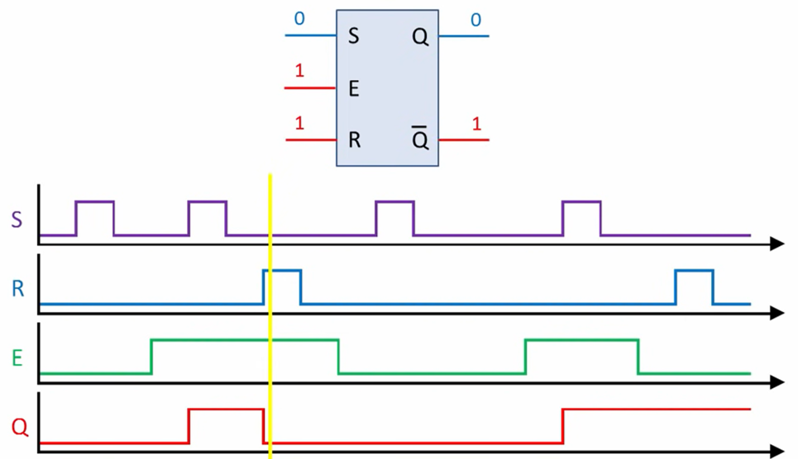
Summary
Latches
A gated latch is a variation on the basic latch.
The gated latch has an additional input, called enable (EN) that must be HIGH in order for the latch to respond to the S and R inputs.

Slide 35
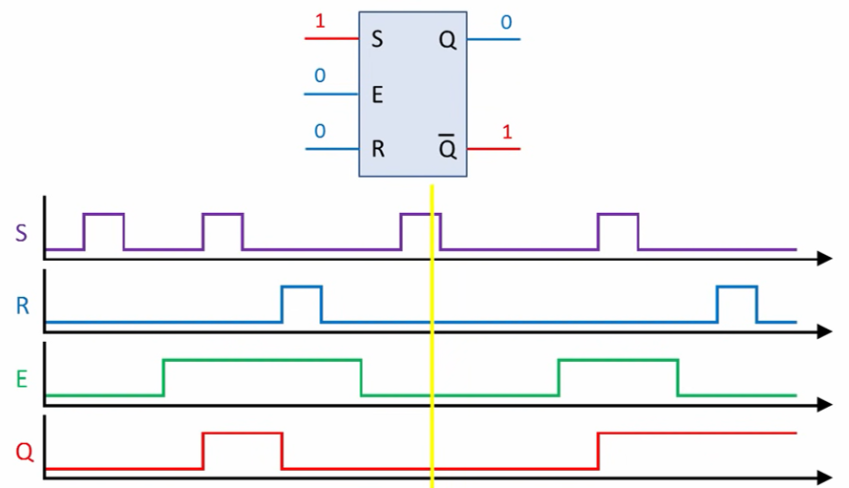
Summary
Latches
A gated latch is a variation on the basic latch.
The gated latch has an additional input, called enable (EN) that must be HIGH in order for the latch to respond to the S and R inputs.

Slide 36
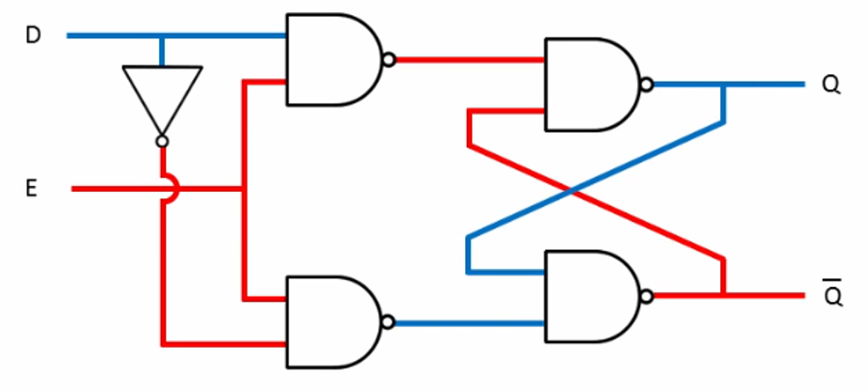
Summary
Latches
The D latch is an variation of the S-R latch but combines the S and R inputs into a single D input as shown:
A simple rule for the D latch is:
Q follows D when the Enable is active.

Slide 37
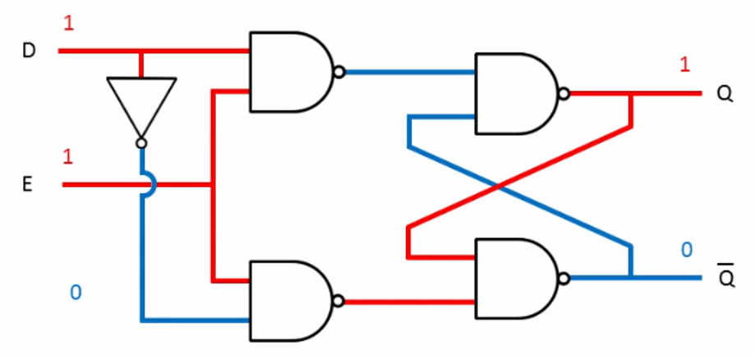
Summary
Latches
The D latch is an variation of the S-R latch but combines the S and R inputs into a single D input as shown:
A simple rule for the D latch is:
Q follows D when the Enable is active.

Slide 38
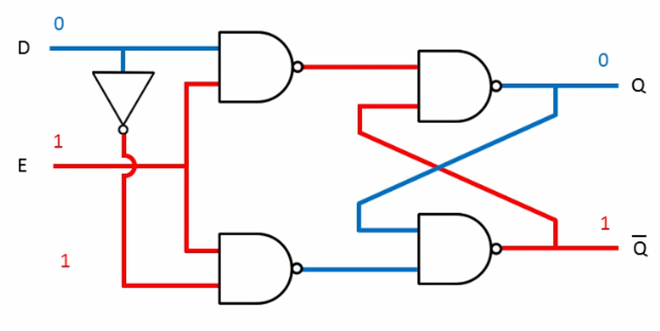
Summary
Latches
The D latch is an variation of the S-R latch but combines the S and R inputs into a single D input as shown:
A simple rule for the D latch is:
Q follows D when the Enable is active.

Slide 39
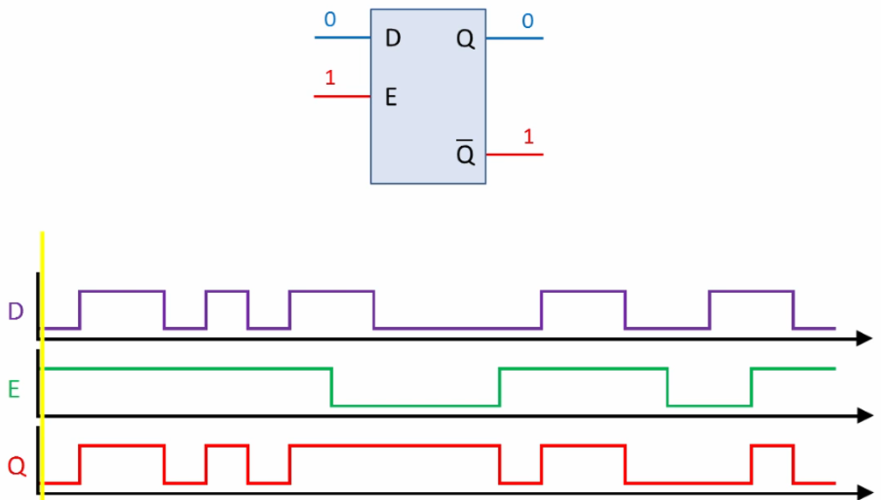
Summary
Latches
The D latch is an variation of the S-R latch but combines the S and R inputs into a single D input as shown:
A simple rule for the D latch is: Q follows D when the Enable is active.

Slide 40
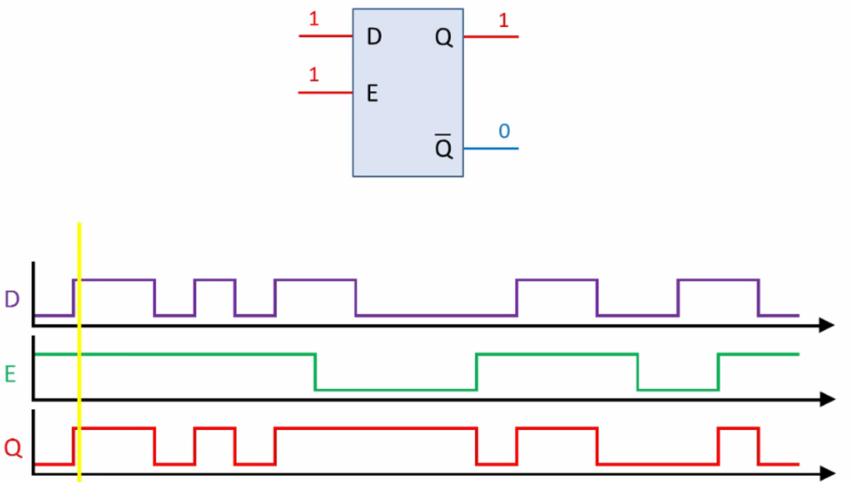
Summary
Latches
The D latch is an variation of the S-R latch but combines the S and R inputs into a single D input as shown:
A simple rule for the D latch is: Q follows D when the Enable is active.

Slide 41
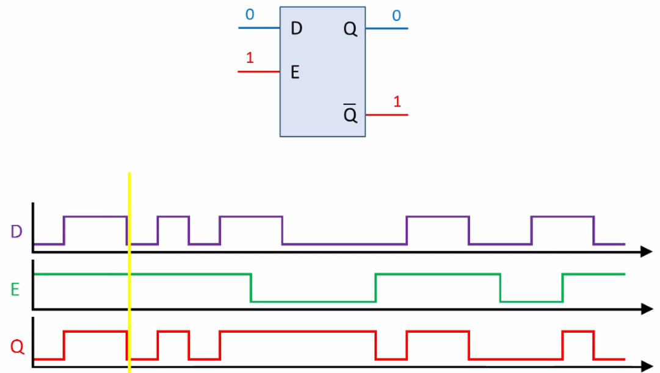
Summary
Latches
The D latch is an variation of the S-R latch but combines the S and R inputs into a single D input as shown:
A simple rule for the D latch is: Q follows D when the Enable is active.

Slide 42
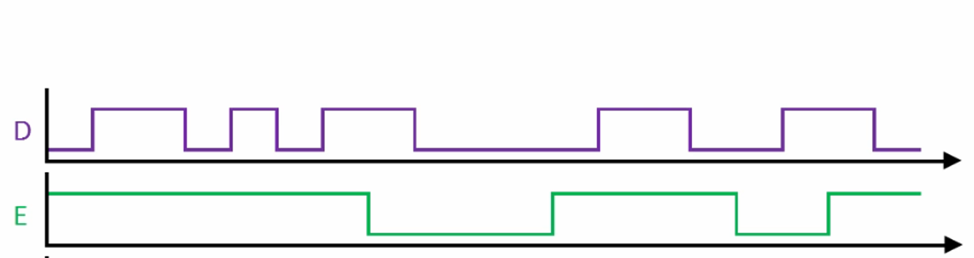
Summary
Latches
The D latch is an variation of the S-R latch but combines the S and R inputs into a single D input as shown:
A simple rule for the D latch is: Q follows D when the Enable is active.

Slide 43
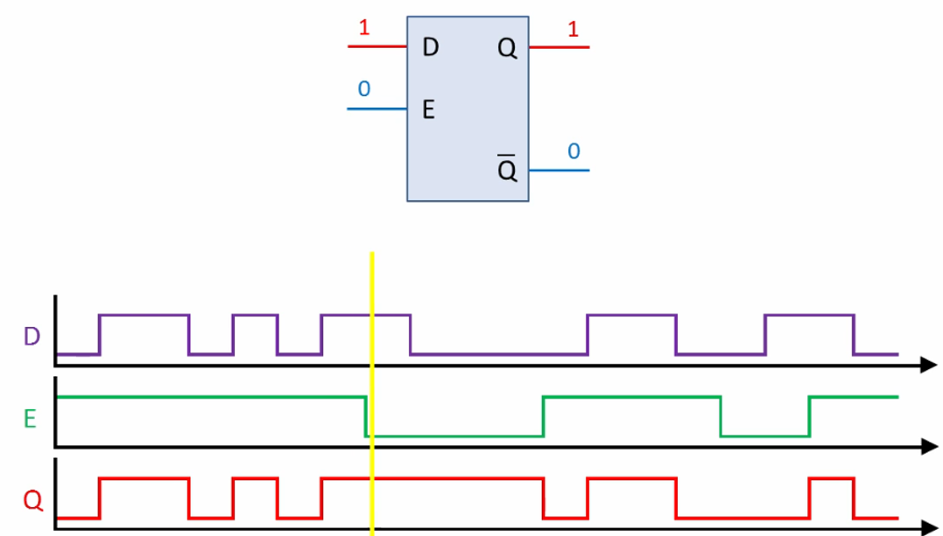
Summary
Latches
The D latch is an variation of the S-R latch but combines the S and R inputs into a single D input as shown:
A simple rule for the D latch is: Q follows D when the Enable is active.

Slide 44
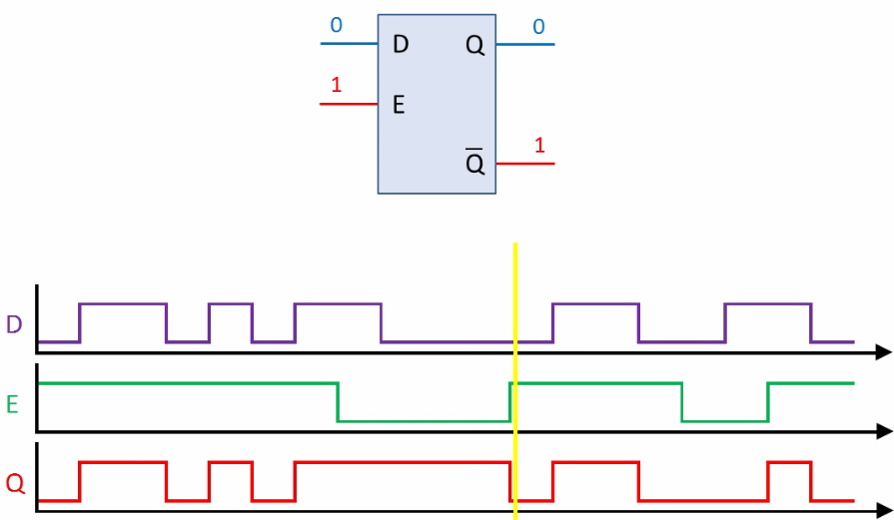
Summary
Latches
The D latch is an variation of the S-R latch but combines the S and R inputs into a single D input as shown:
A simple rule for the D latch is: Q follows D when the Enable is active.

Slide 45
Summary
Latches
The truth table for the D latch summarizes its operation. If EN is LOW, then there is no change in the output and it is latched.

Slide 46
Memory Element
Flip-Flop
Latch
Stores 1-bit of Information (1 or 0 )
Two Stable States – Bi-stable

Slide 47
Memory Element
Flip-Flop
Latch
1
1
Latch
Input
Output

Slide 48
Memory Element
Flip-Flop
Latch
0
0
Latch
Input
Output
Asynchronous Memory Element
Transparent Latch

Slide 49
Memory Element
Flip-Flop
Latch
Input
Gated
Latch
Enable
Output

Slide 50
Memory Element
CLK
Input
Gated
Latch
Enable
Output
Level Sensitive

Slide 51
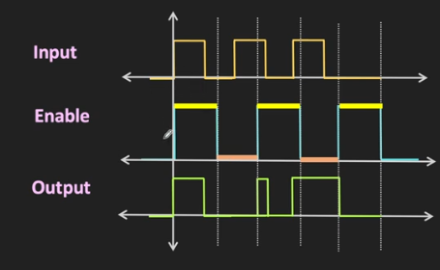
Memory Element
CLK
Input
Gated
Latch
Enable
Output

Slide 52
Memory Element
Flip-Flop
Latch
Input
Flip-Flop
Input
Input
Gated
Latch
CLK
Enable
Output
Edge Triggered
Level Triggered

Slide 53
Flip-Flop
Input
Flip-Flop
Input
CLK
Rising Edge
Positive Edge Triggered
Falling Edge
Negative Edge Triggered

Slide 54
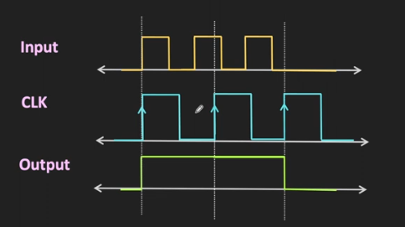
Flip-Flop
Input
Flip-Flop
Input
CLK
Positive Edge Triggered

Slide 55
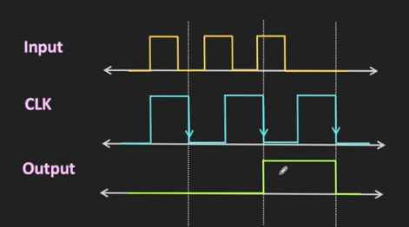
Flip-Flop
Input
Flip-Flop
Input
CLK
Negative Edge Triggered

Slide 56
Latch
Flip-Flop
Input
CLK
Gated
Latch
Input
Flip-Flop
Output
Input
Enable
CLK
Positive Edge Triggered

Slide 57
Gated Latch
CLK
Transition
Circuit
Input
Gated
Latch
Output
Enable
Flip-Flop
Input
Flip-Flop
Input
CLK

Slide 58
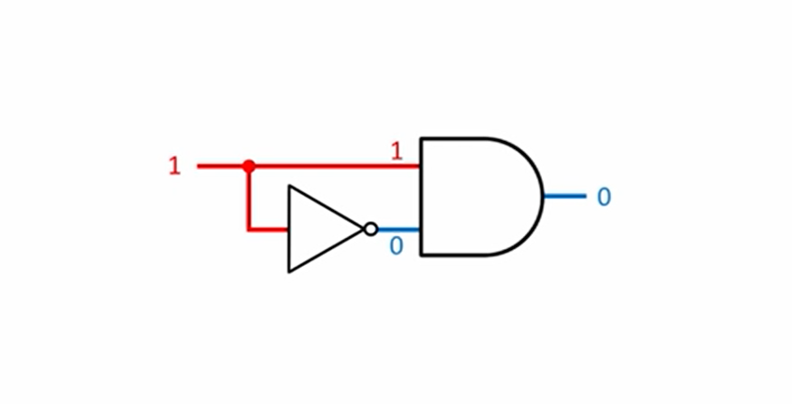
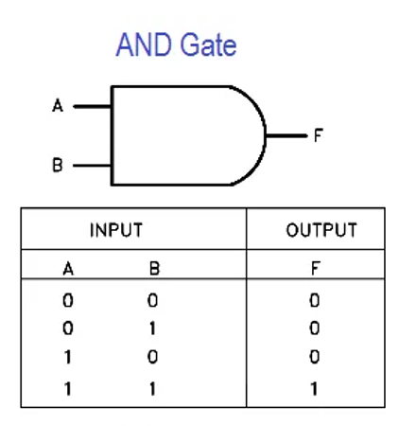
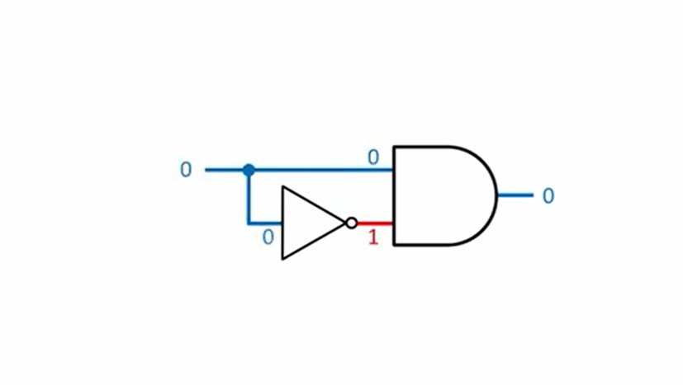
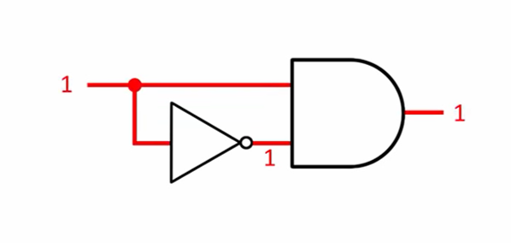

Slide 59
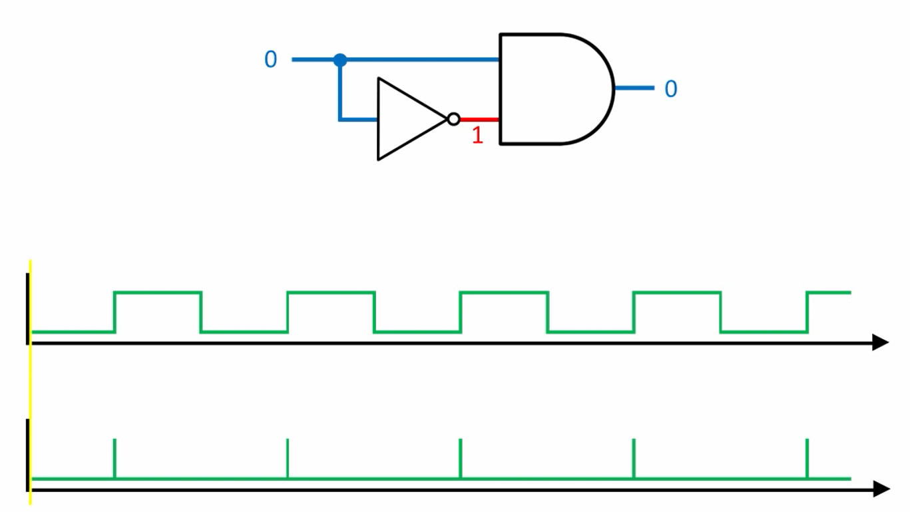

Slide 60
Summary
Flip-flops
A flip-flop differs from a latch in the manner it changes states. A flip-flop is a clocked device, in which only the clock edge determines when a new bit is entered.
The active edge can be positive or negative.
Dynamic input indicator

Slide 61
Summary
Flip-flops
The truth table for a positive-edge triggered D flip-flop shows an up arrow to remind you that it is sensitive to its D input only on the rising edge of the clock; otherwise it is latched. The truth table for a negative-edge triggered D flip-flop is identical except for the direction of the arrow.
(a) Positive-edge triggered (b) Negative-edge triggered

Slide 62
Summary
Flip-flops
The J-K flip-flop is more versatile than the D flip flop. In addition to the clock input, it has two inputs, labeled J and K. When both J and K = 1, the output changes states (toggles) on the active clock edge (in this case, the rising edge).

Slide 63
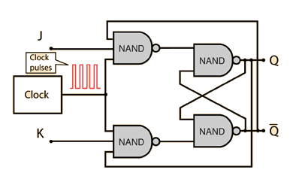
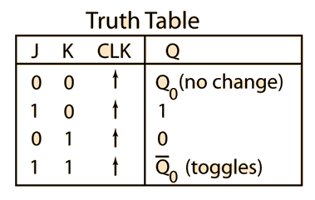
Summary
Flip-flops
The J-K flip-flop is more versatile than the D flip flop. In addition to the clock input, it has two inputs, labeled J and K. When both J and K = 1, the output changes states (toggles) on the active clock edge (in this case, the rising edge).

Slide 64
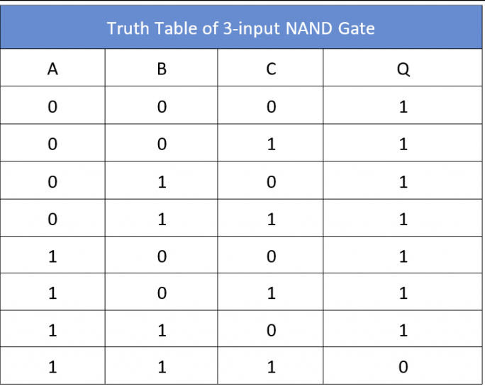
Summary
J-K Flip-flops

Slide 65
Summary
Flip-flops
Q
J
Example
Determine the Q output for the J-K flip-flop, given the inputs shown.
CLK
K
Q
Notice that the outputs change on the leading edge of the clock.
Solution
Set
Toggle
Set
Latch
CLK
J
K
Q

Slide 66
Summary
Flip-flops
A D-flip-flop does not have a toggle mode like the J-K flip-flop, but you can hardwire a toggle mode by connecting Q back to D as shown. This is useful in some counters as you will see in Chapter 8.
D
Q
For example, if Q is LOW, Q is HIGH and the flip-flop will toggle on the next clock edge. Because the flip-flop only changes on the active edge, the output will only change once for each clock pulse.
CLK
CLK
Q
D flip-flop hardwired for a toggle mode

Slide 67
Summary
Flip-flops
Synchronous inputs are transferred in the triggering edge of the clock (for example the D or J-K inputs). Most flip-flops have other inputs that are asynchronous, meaning they affect the output independent of the clock.
PRE
Two such inputs are normally labeled preset (PRE) and clear (CLR). These inputs are usually active LOW. A J-K flip flop with active LOW preset and CLR is shown.
Q
J
CLK
K
Q
CLR

Slide 68
Summary
PRE
Flip-flops
Flip-flops
Q
J
Example
CLK
Determine the Q output for the J-K flip-flop, given the inputs shown.
K
Q
Solution
CLR
Set
Toggle
Set
Reset
Toggle
Latch
CLK
J
K
Set
PRE
Reset
CLR
Q

Slide 69
Summary
Flip-flop Characteristics
Other specifications include maximum clock frequency, minimum pulse widths for various inputs, and power dissipation. The power dissipation is the product of the supply voltage and the average current required.
A useful comparison between logic families is the speed-power product which uses two of the specifications discussed: the average propagation delay and the average power dissipation. The unit is energy.
Example
What is the speed-power product for 74AHC74A? Use the data from Table 7-5 to determine the answer.
Solution
From Table 7-5, the average propagation delay is 4.6 ns. The quiescent power dissipated is 1.1 mW. Therefore, the speed-power product is
5 pJ

